Slide 1
#6 – How to treat people who hurt you

Slide 2
How to treat people who hurt you
Be Generous with Grace! - v38-42
‘Eye for eye, tooth for tooth’

Slide 3
How to treat people who hurt you
Be Generous with Grace! - v38-42
‘Eye for eye, tooth for tooth’
Accept insults – v39

Slide 4
How to treat people who hurt you
Be Generous with Grace! - v38-42
‘Eye for eye, tooth for tooth’
Accept insults – v39
Don’t stand on you rights – v40

Slide 5
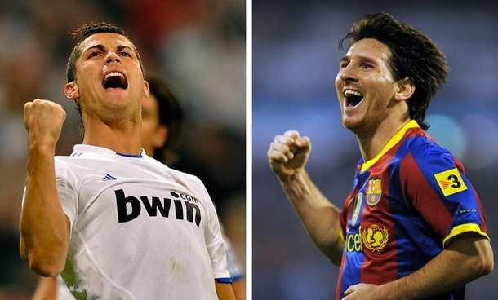

Slide 6
How to treat people who hurt you
Be Generous with Grace! - v38-42
‘Eye for eye, tooth for tooth’
Accept insults – v39
Don’t stand on you rights – v40
Be generous with your time and effort – v41

Slide 7
How to treat people who hurt you
Be Generous with Grace! - v38-42
‘Eye for eye, tooth for tooth’
Accept insults – v39
Don’t stand on you rights – v40
Be generous with your time and effort – v41
Be generous with your possessions – v42

Slide 8
How to treat people who hurt you
Be stingy with hate! – v43-48
‘Love your enemies

Slide 9
How to treat people who hurt you
Be stingy with hate! – v43-48
‘Love your enemies
- Seek their good, not harm
- An act of the will, not a feeling

