Slide 1
The parable of the treasure in the field.
Matthew 13v44-46

Slide 2
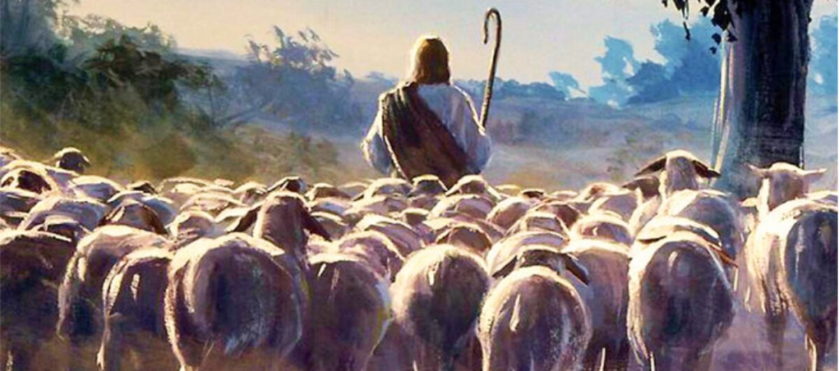

Slide 3
“I thank you, God, that I am not a Gentile, a woman, or a slave.” A Jewish man’s prayer!

Slide 4
Being in relationship with God was a matter of faith not family

Slide 5
Being in relationship with God was a matter of faith not family

Slide 6
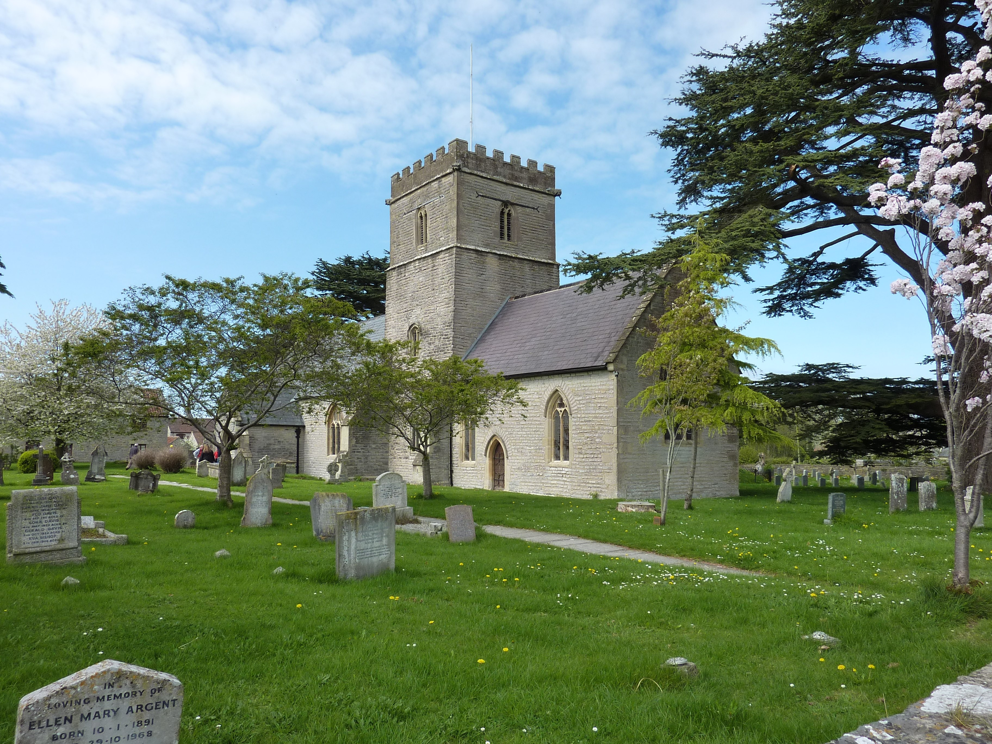

Slide 10
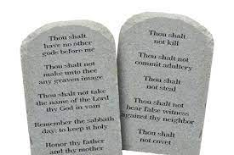

Slide 11
‘He is no fool who gives up what he cannot keep in order to gain what he cannot lose.’ Jim Elliot

