Slide 1
#3 – How to be right with God

Slide 2
How to be Right with God
Jesus Endorsed the Old Testament - v17-18

Slide 3
How to be Right with God
Jesus Endorsed the Old Testament - v17-18
Every part of it

Slide 4
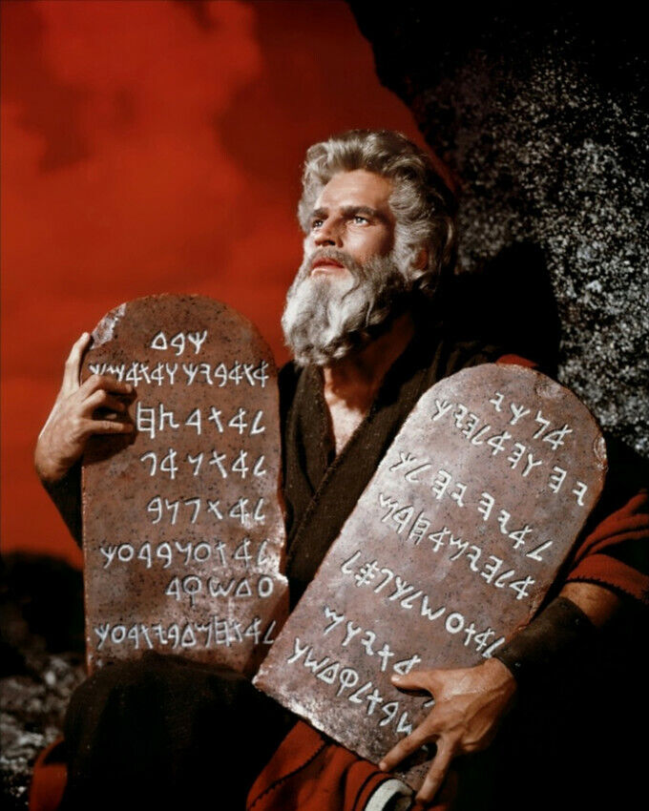
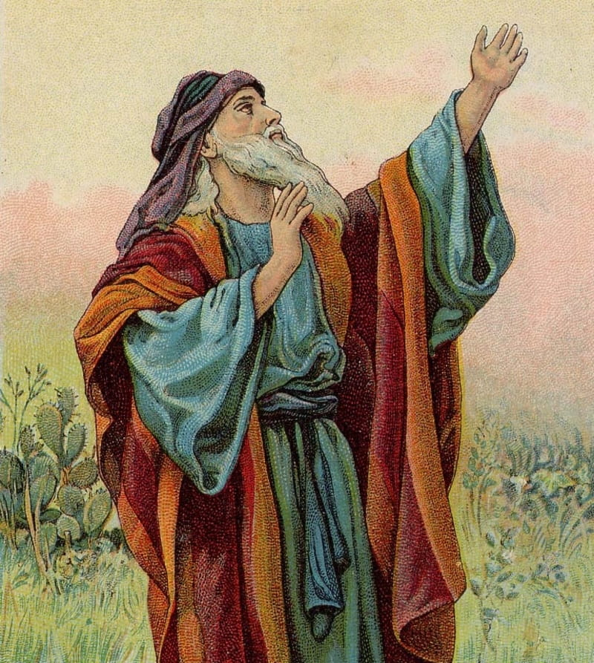

Slide 5
How to be Right with God
Jesus Endorsed the Old Testament - v17-18
Every part of it
Every truth of it

Slide 6
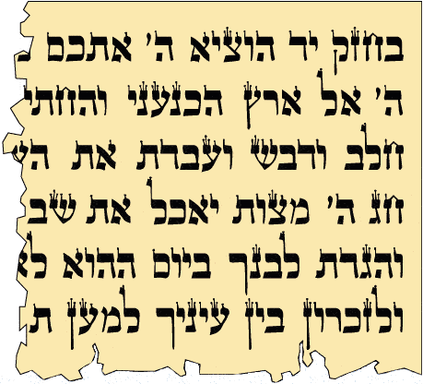

Slide 7
How to be Right with God
Jesus Endorsed the Old Testament - v17-18
Jesus Fulfilled the Old Testament

Slide 8
How to be Right with God
Jesus Endorsed the Old Testament - v17-18
Jesus Fulfilled the Old Testament
Doctrinal teaching

Slide 10
How to be Right with God
Jesus Endorsed the Old Testament - v17-18
Jesus Fulfilled the Old Testament
Doctrinal teaching
Predictive prophecy, inc. ‘Types’ or ‘shadows’

Slide 11
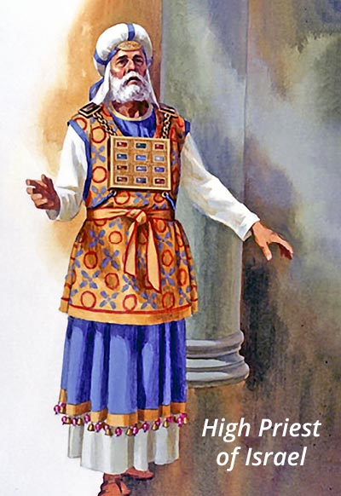
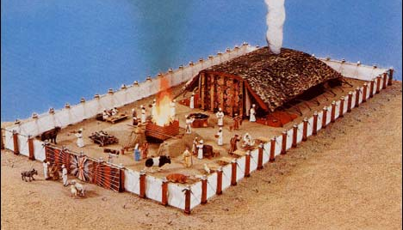

Slide 12
How to be Right with God
Jesus Endorsed the Old Testament - v17-18
Jesus Fulfilled the Old Testament
Doctrinal teaching
Predictive prophecy, inc. ‘Types’ or ‘shadows’
The Moral law

Slide 13
How to be Right with God
Jesus Endorsed the Old Testament - v17-18
Jesus Fulfilled the Old Testament
Doctrinal teaching
Predictive prophecy, inc. ‘Types’ or ‘shadows’
The Moral law
He kept it
He deepened it

Slide 14
How to be Right with God
Jesus Endorsed the Old Testament - v17-18
Jesus Fulfilled the Old Testament
Jesus Applied the Old Testament - v19-20

Slide 15
How to be Right with God
Jesus Endorsed the Old Testament - v17-18
Jesus Fulfilled the Old Testament
Jesus Applied the Old Testament - v19-20
Don’t play fast and loose with the law of God – v19

Slide 16
How to be Right with God
Jesus Endorsed the Old Testament - v17-18
Jesus Fulfilled the Old Testament
Jesus Applied the Old Testament - v19-20
Don’t play fast and loose with the law of God – v19
Encourage others to keep it – v19

Slide 17
How to be Right with God
Jesus Endorsed the Old Testament - v17-18
Jesus Fulfilled the Old Testament
Jesus Applied the Old Testament - v19-20
Don’t play fast and loose with the law of God – v19
Encourage others to keep it – v19
Obtain a deeper righteousness, not just more – v20

