Slide 1
#2 – How to be a positive influence

Slide 3
How to be a positive influence
Salt
Purity

Slide 4
Let your conversation always be full of grace, seasoned with salt.
Colossians 4v6

Slide 5
How to be a positive influence
Salt
Purity
Preserving

Slide 7
How to be a positive influence
Salt
Purity
Preserving
Flavour

Slide 8
If the salt loses its saltiness, how can it be made salty again?
Matthew 5v13

Slide 9
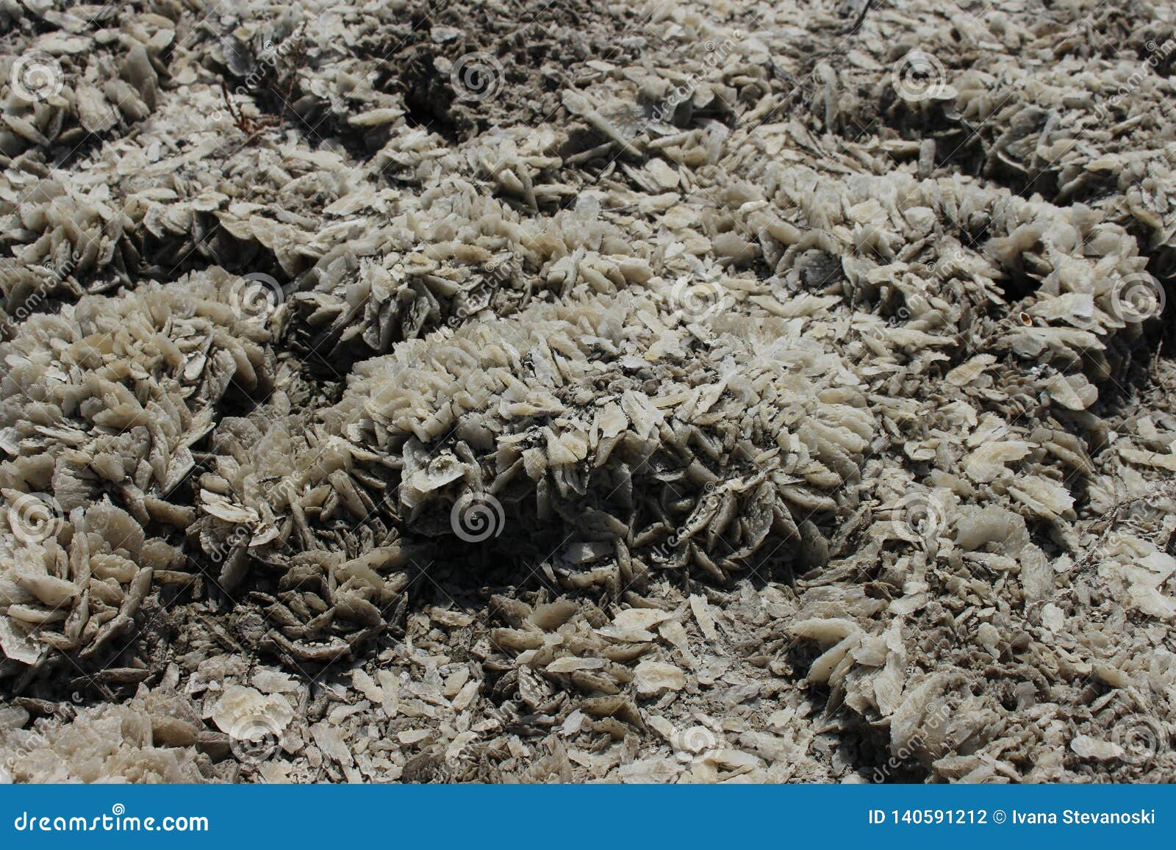

Slide 10
How to be a positive influence
Salt
Purity
Preserving
Flavour
Light

Slide 11
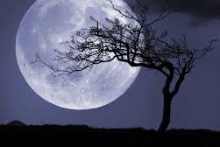

Slide 12
How to be a positive influence
Salt
Purity
Preserving
Flavour
Light
Needs to be visible

Slide 13
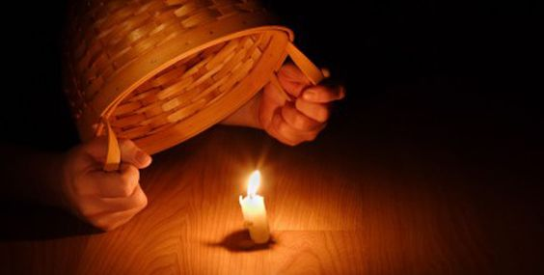

Slide 14
How to be a positive influence
Salt
Purity
Preserving
Flavour
Light
Needs to be visible
Guides

Slide 16
How to be a positive influence
Salt
Purity
Preserving
Flavour
Light
Needs to be visible
Guides
Warns

Slide 19
How to be a positive influence
Salt
Purity
Preserving
Flavour
Light
Needs to be visible
Guides
Warns
Attracts

Slide 21
How to be a positive influence
Salt
Purity
Preserving
Flavour
Light
Needs to be visible
Guides
Warns
Attracts

