Slide 1
Romans
The power of the Gospel

Slide 2
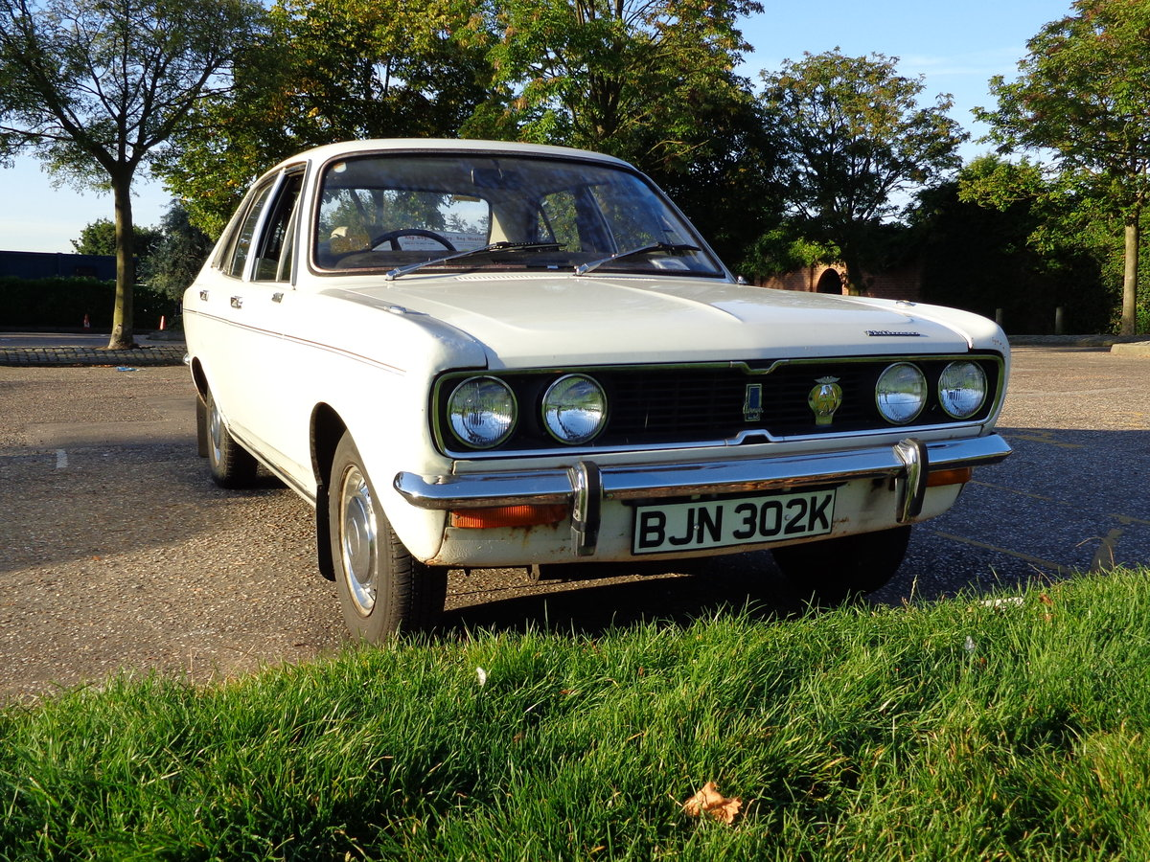
Be Who You Are
Romans Ch 6v1-14

Slide 3
Who is your master?
Romans Ch 6v15-23
Since God will forgive me no matter what, why not carry on as before?
Answer:
Because you are united to Jesus! v2-4

Slide 4
Who is your master?
Romans Ch 6v15-23
The 1st key to experiencing the full blessings of Jesus
Believe that you are united to Jesus

Slide 5
Who is your master?
Romans Ch 6v15-23
Romans 6v15
‘Shall we sin because we are not under the law but under grace?’

Slide 6
Who is your master?
Romans Ch 6v15-23
Romans 6v1
‘Shall we go on sinning’
=
Shall we carry on as before?

Slide 7
Who is your master?
Romans Ch 6v15-23
Romans 6v15
‘Shall we sin’
=
‘Shall we sin just once since ….’

Slide 8
Who is your master?
Romans Ch 6v15-23
The 2nd key to experiencing the full blessings of Jesus
Full commitment to Jesus

Slide 9
Who is your master?
Romans Ch 6v15-23
Obedience opens the way to victory
Disobedience opens the door to defeat and powerlessness.

Slide 10
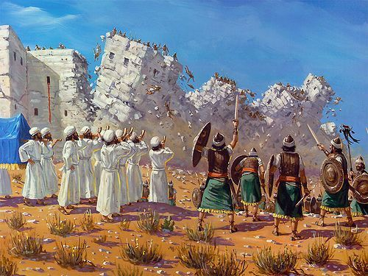

Slide 11
