Slide 1
‘The Armour of God’ [Pt1]
The Belt of Truth [Ephesians 6:14]

Slide 2
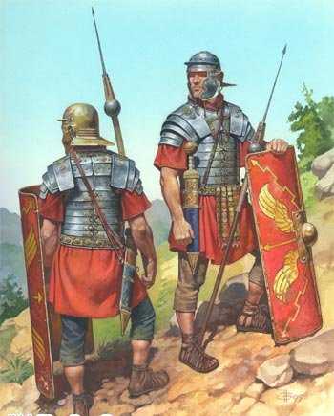

Slide 3
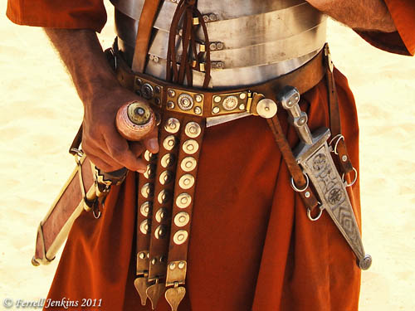
‘The Belt of Truth’

Slide 4
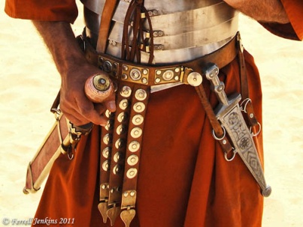
‘The Belt of Truth’
The Belt of Foundational Truth
‘I … urge you to contend for the faith that was once for all entrusted to God’s holy people. Jude v3

Slide 5
‘The Belt of Truth’
The Belt of Foundational Truth
We need to know The Truth because
uncertainty about what we believe leaves us very open to attack.

Slide 6
‘The Belt of Truth’
The Belt of Foundational Truth
We need to know The Truth because
uncertainty about what we believe leaves us very open to attack.
it matters to Jesus, our master and leader!

Slide 7
‘The Belt of Truth’
The Belt of Foundational Truth
We need to know The Truth because
uncertainty about what we believe leaves us very open to attack.
it matters to Jesus, our master and leader!
we are called to be different to the rest of society.

Slide 8
‘The Belt of Truth’
The Belt of Foundational Truth
We need to know The Truth because
uncertainty about what we believe leaves us very open to attack.
it matters to Jesus, our master and leader!
we are called to be different to the rest of society.
we live in a culture governed by feelings

Slide 9
‘The Belt of Truth’
The Belt of Truth of Heart

Slide 10
‘The Belt of Truth’
The Belt of Truth of Heart
Honesty (Integrity) binds everything else in place.

Slide 11
‘The Belt of Truth’
The Belt of Truth of Heart
Honesty (Integrity) binds everything else in place.
Honesty attracts people, but falseness and hypocrisy turn people off!

Slide 12
‘The Belt of Truth’
‘Sincerity is the strength of every grace - the more hypocrisy in our graces, the weaker they are; it is sincere faith which is strong faith, sincere love which is mighty love. But hypocrisy is to grace as rust is to iron - it weakens it because it is corrupt.’
William Gurnall

Slide 13
‘The Belt of Truth’
The Belt of Truth of Heart
Honesty (Integrity) binds everything else in place.
Honesty attracts people, but falseness and hypocrisy turn people off!
Honesty is characteristic of children

