Slide 1
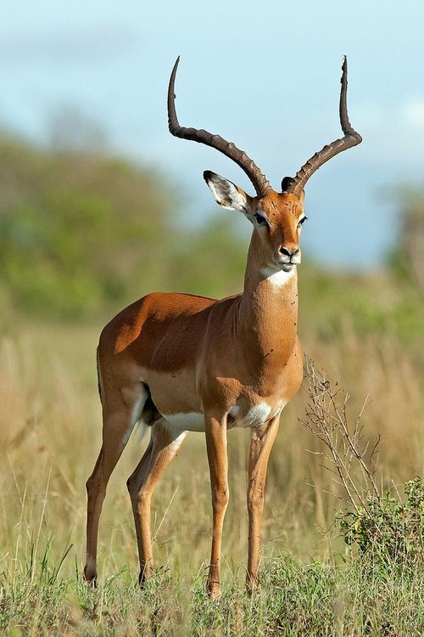
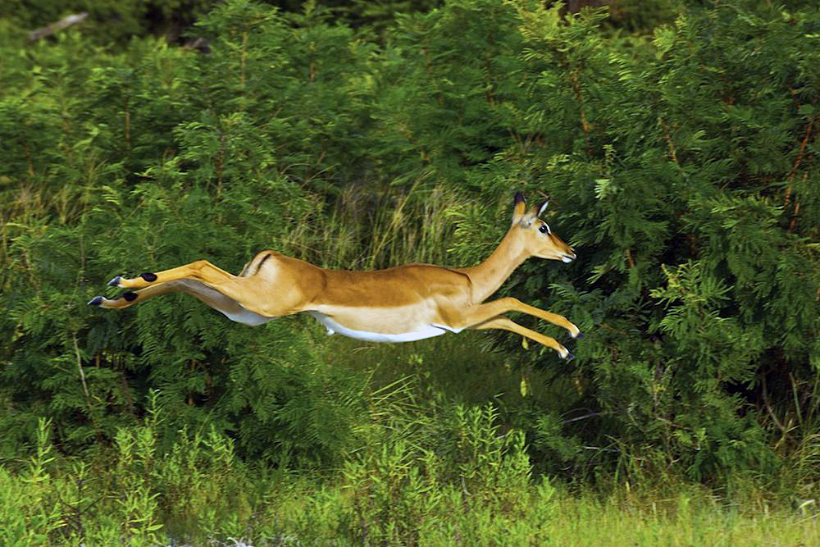

Slide 3
Faith means we can remove rooftops
Have you settled for less than what God is able to do?
2. Are you on the roof or in the crowd?
Are unbelief, cynicism & criticism blocking your faith in a wonder-working, sin forgiving saviour?
3. Faith is trusting God for what we need, not what we want.
Are you pursuing Jesus to make yourself feel good or to have your sins forgiven?

