Slide 1
#1 – The Be Attitudes

Slide 2
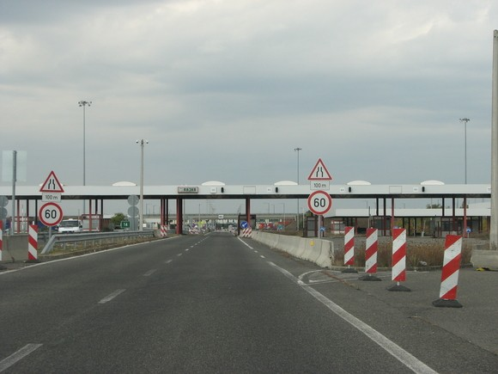

Slide 3
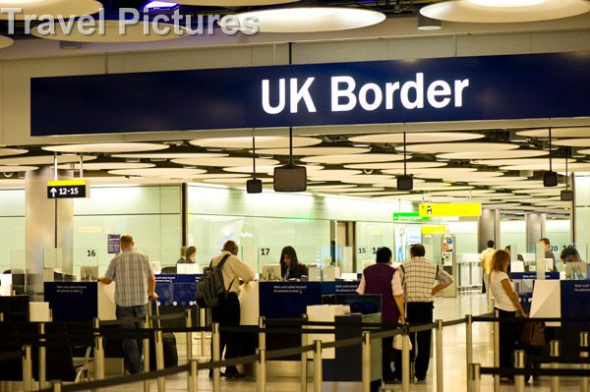

Slide 4
The Beatitudes
In Jesus kingdom attitudes come first, then actions

Slide 5
The Beatitudes
Blessed are the poor in spirit - v3: spiritually humble

Slide 6
The Beatitudes
Blessed are the poor in spirit - v3
Blessed are those who mourn - v4: take sin seriously

Slide 7
The Beatitudes
Blessed are the poor in spirit - v3
Blessed are those who mourn - v4
Blessed are the meek - v5: humble towards God and other people.

Slide 8
The Beatitudes
Blessed are the poor in spirit - v3
Blessed are those who mourn - v4
Blessed are the meek - v5
Blessed are those who hunger and thirst for righteousness (v6) - Clean in God’s sight

Slide 9
The Beatitudes
Blessed are the poor in spirit - v3
Blessed are those who mourn - v4
Blessed are the meek - v5
Blessed are those who hunger and thirst for righteousness - v6
Blessed are the merciful - v7: treating other people kindly

Slide 10
The Beatitudes
Blessed are the poor in spirit - v3
Blessed are those who mourn - v4
Blessed are the meek - v5
Blessed are those who hunger and thirst for righteousness - v6
Blessed are the merciful - v7
Blessed are the pure in heart – v8: unmixed, unadulterated

Slide 11
The Beatitudes
Blessed are the poor in spirit - v3
Blessed are those who mourn - v4
Blessed are the meek - v5
Blessed are those who hunger and thirst for righteousness - v6
Blessed are the merciful - v7
Blessed are the pure in heart – v8
Blessed are the peacemakers – v9: between people, and God

Slide 12
The Beatitudes
Blessed are the poor in spirit - v3
Blessed are those who mourn - v4
Blessed are the meek - v5
Blessed are those who hunger and thirst for righteousness - v6
Blessed are the merciful - v7
Blessed are the pure in heart – v8
Blessed are the peacemakers – v9
Blessed are those who are persecuted because of righteousness - v10: This just confirms you place in heaven!

