Slide 1
‘The Armour of God’ [Pt5]
The Helmet of Salvation & the Sword of the spirit [Ephesians 6:17]

Slide 2
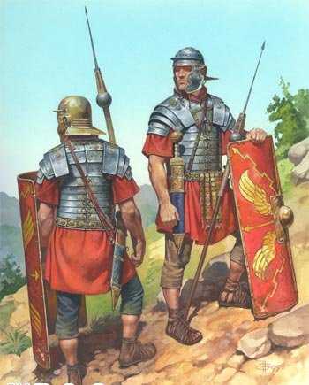

Slide 3
‘The Helmet of Salvation’
‘Putting on …the hope of salvation as a helmet’. 1 Thessalonians 5:8
The ‘helmet of salvation’ = the hope we have in Jesus.

Slide 4
‘The Helmet of Salvation’
Of the 25 most pessimistic men, 21 had died 8 years later.
Of the 25 most optimistic, only 6 had died!
“Loss of hope increased the odds of death more than 300 percent; it predicted death more accurately than any medical risk factor, including blood pressure, amount of damage to the heart, or cholesterol level."
(Chris Peterson, "Optimism and By-pass Surgery,")

Slide 5
‘The Helmet of Salvation’
‘If I fought wild beasts in Ephesus for merely human reasons, what have I gained? If the dead are not raised, “Let us eat and drink, for tomorrow we die.
1 Corinthians 15:32

Slide 6
‘The Helmet of Salvation’
Therefore we do not lose heart, …. For our light and momentary troubles are achieving for us an eternal glory that far outweighs them all.’
2 Corinthians 4v17

Slide 7
‘The Helmet of Salvation’
So be truly glad. There is wonderful joy ahead, even though you must endure many trials for a little while. These trials will show that your faith is genuine …

Slide 8
… It is being tested as fire tests and purifies gold—though your faith is far more precious than mere gold. …

Slide 9
… So when your faith remains strong through many trials, it will bring you much praise and glory and honour on the day when Jesus Christ is revealed to the whole world.
1 Peter 1:3-7.

Slide 10
‘The Helmet of Salvation’
Who for the joy set before him endured the cross, scorning its shame …’.
Hebrews 12:2

Slide 12
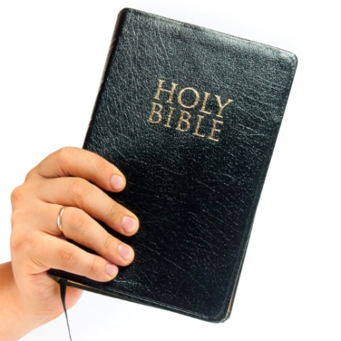
The sword of the Spirit – which is the word of God
The sword of the Spirit

Slide 13
The sword of the Spirit – which is the word of God
The sword of the Spirit
The Word of God is the sword the Spirit uses

Slide 14
The sword of the Spirit – which is the word of God
The sword of the Spirit
The Word of God is the sword the Spirit uses
‘Rhema’ = the specific, applied word for a given situation

Slide 15
The sword of the Spirit – which is the word of God
‘The Word of God is alive and powerful, it is sharper than the sharpest two edged sword … it exposes our innermost thoughts and desires.
Hebrews 4:12

